Slide 1
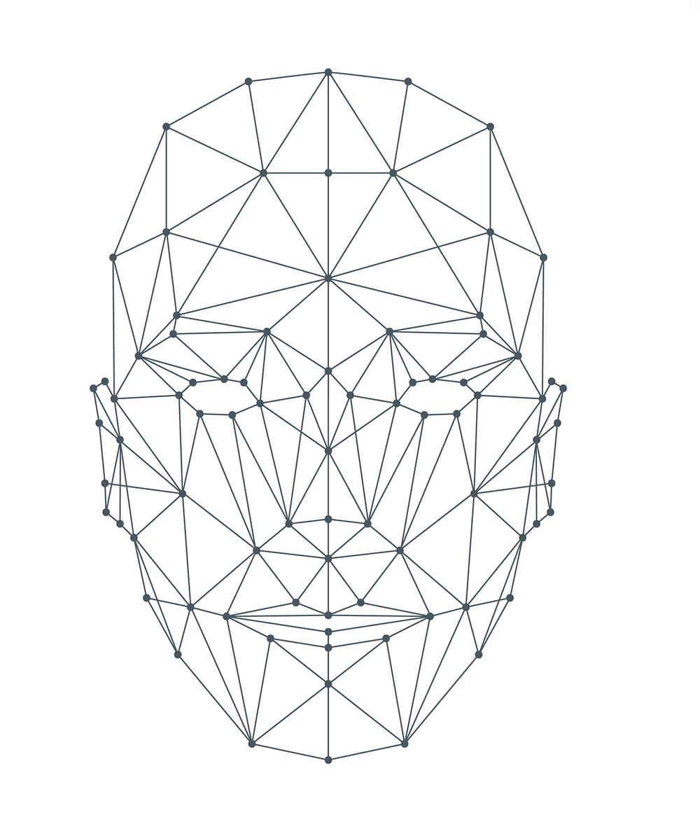
Vehicle Security System through Face Recognition
Sugumar N
Vishal S
Praveen R

Slide 2
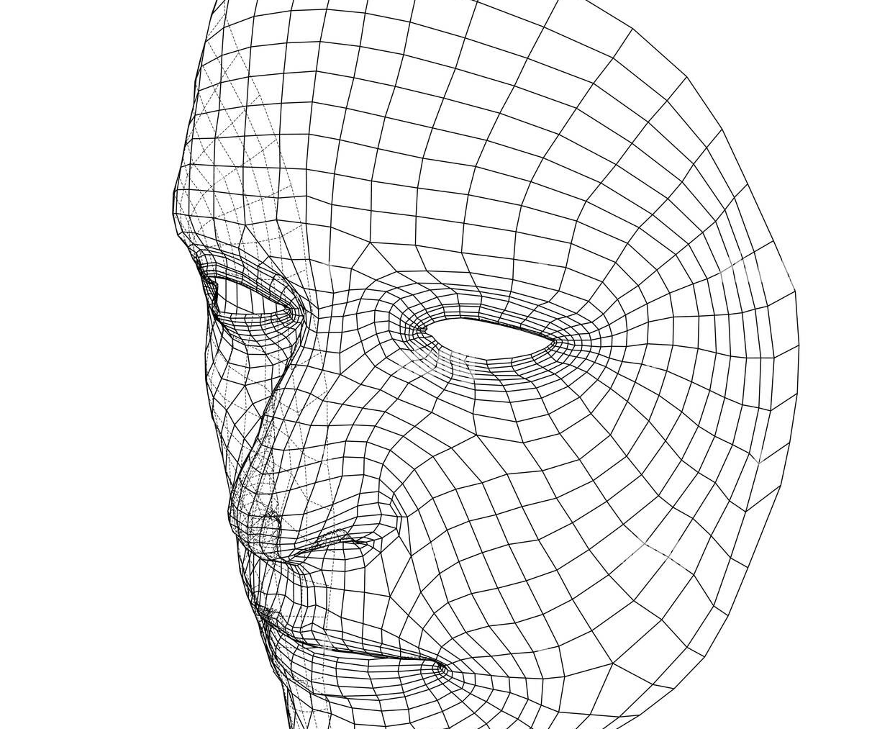
Agenda
Introduction
Face recognition system
Liveness detection
unauthorized access
New system inclusion

Slide 3
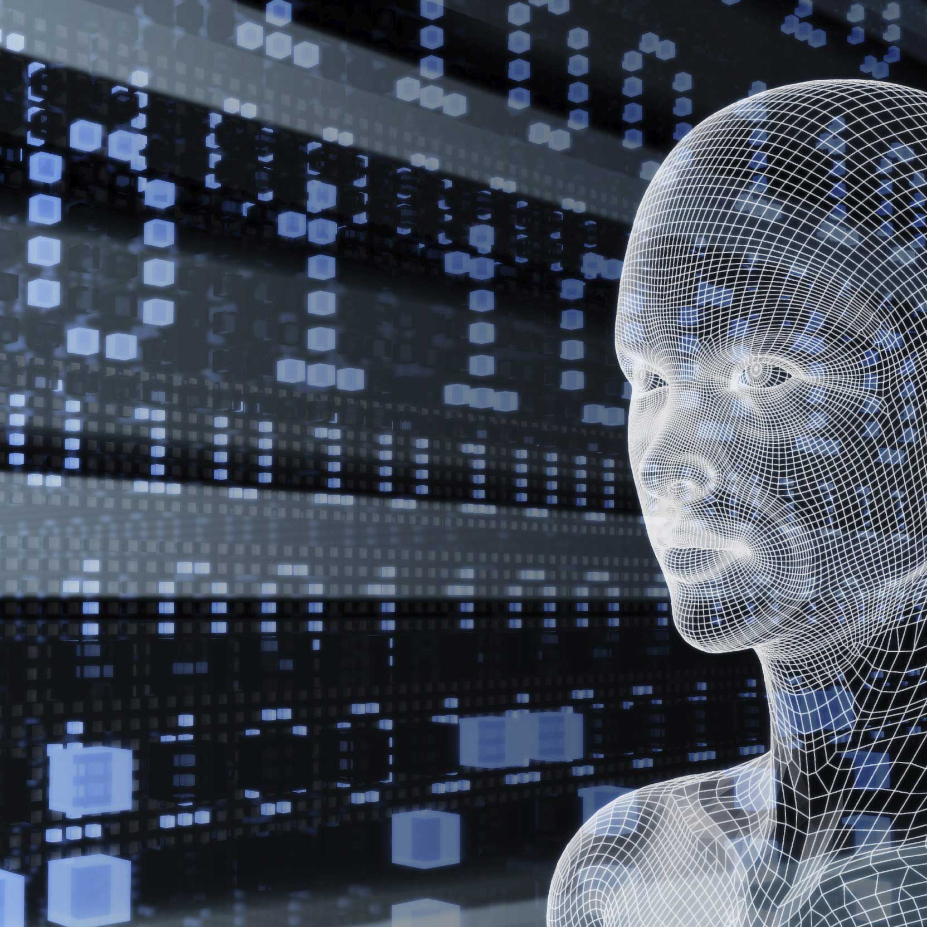
Introduction
Computer vision has being played a significant role in biometric identification and user recognition.
Biometric identification based security systems are considered to be the most secure due to their ability to identify people with minimal ambiguity.
Implementation of biometric authorization in the vehicles as machine vision technology provides a new level of theft detection
Extra security by monitoring the presence of intruders inside the vehicle.

Slide 4

Face recognition system
Building a model for face detection
Finding the encodings of the detected face
Save the encodings
Compare the real-time face encodings with the pre trained model’s encodings
Algorithm that control anti spoofing

Slide 5
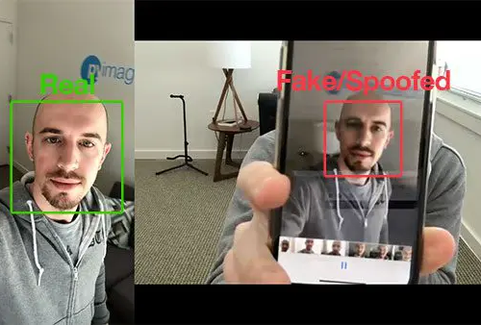
Liveness detection
Texture analysis
Active flash
Heuristic-based algorithms
Optical Flow algorithms

Slide 6
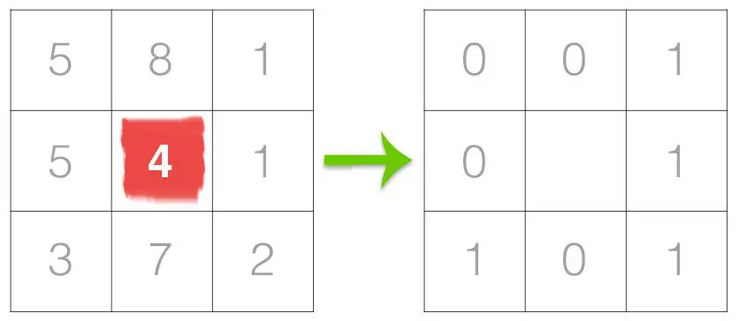
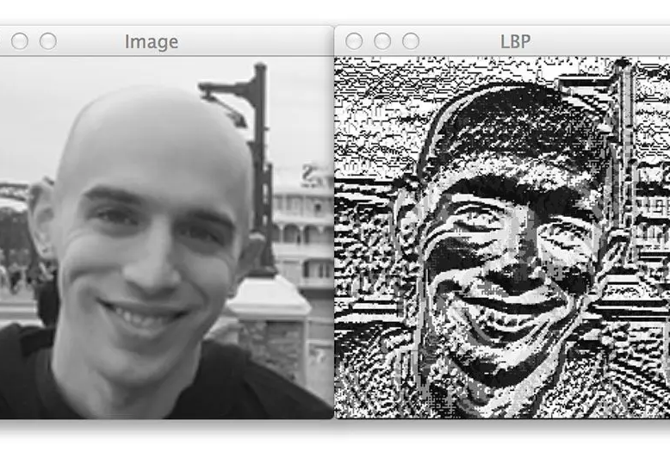
Texture analysis
compares each pixel with its surrounding neighborhood of pixels.
This process of thresholding, accumulating binary strings, and storing the output decimal value in the LBP array is then repeated for each pixel in the input image.

Slide 7
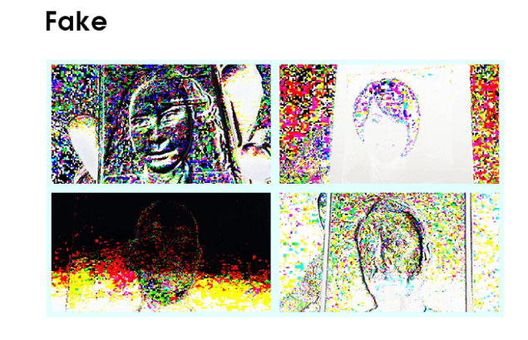
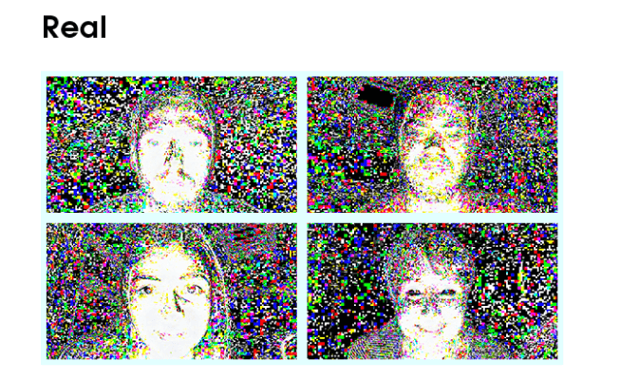
Active flash
It allows liveness detection using light reflections on a face.
Frames before and after active flashing provide the data sample for training the network

Slide 8
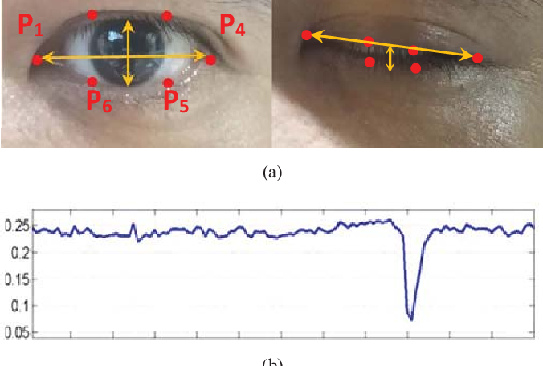
Optical flow method
Optical flow is a technique used to describe image motion.
It is usually applied to a series of images that have a small time step between them, for example, video frames.

Slide 9
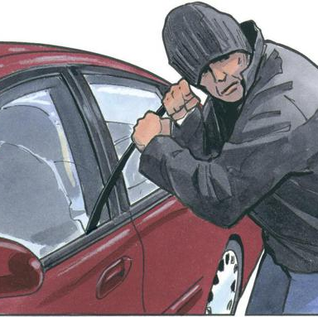



Unauthorized access
The code will decline up-to 20 times.
After that it will starts to send the location in means of latitude and longitude, to the users personal device.
And the data will also be stored in the database.
Which can be used to identify if the vehicle.

Slide 10

New system inclusion
drowsiness detection
Child protection
Focus manager
Personalized in-cabin experience
The system will compute a person’s eyes data and warns him about the drowsiness.
This system also uses the eye data to check the location of the eyes target.
The data collected previously can be used automatically adjust car settings to each user’s personal preferences.
The control in the hands of the child can also be detected and the safety measures can be applied.

Slide 11
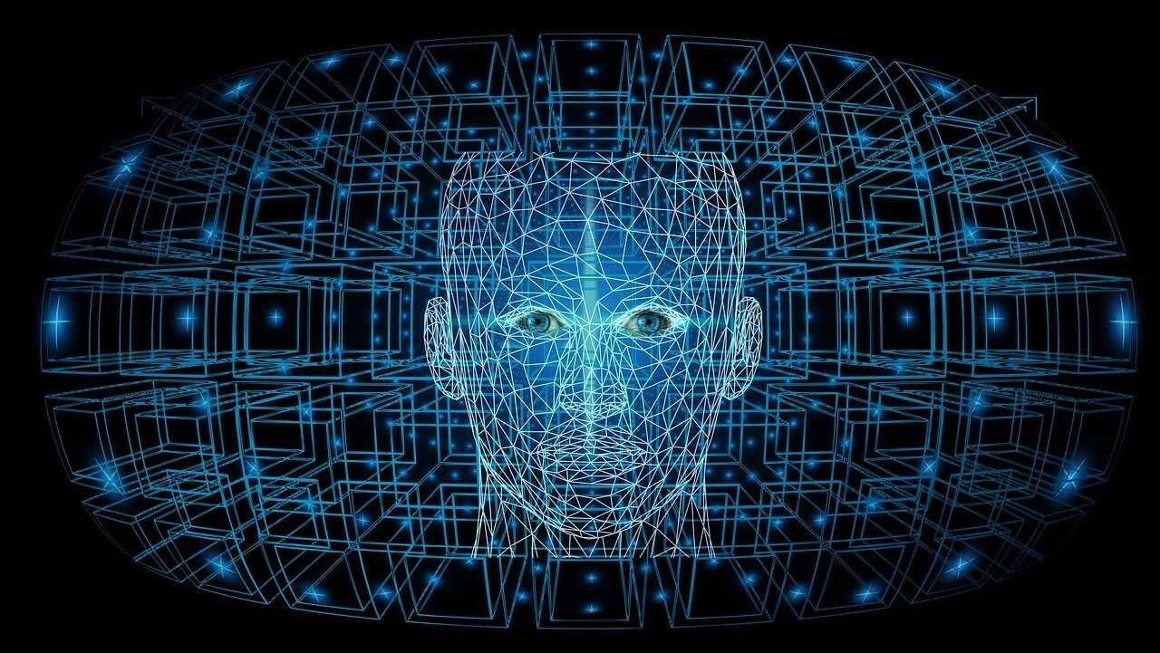
Thank you
Mirjam Nilsson​
mirjam@contoso.com | www.contoso.com

